Slide 1
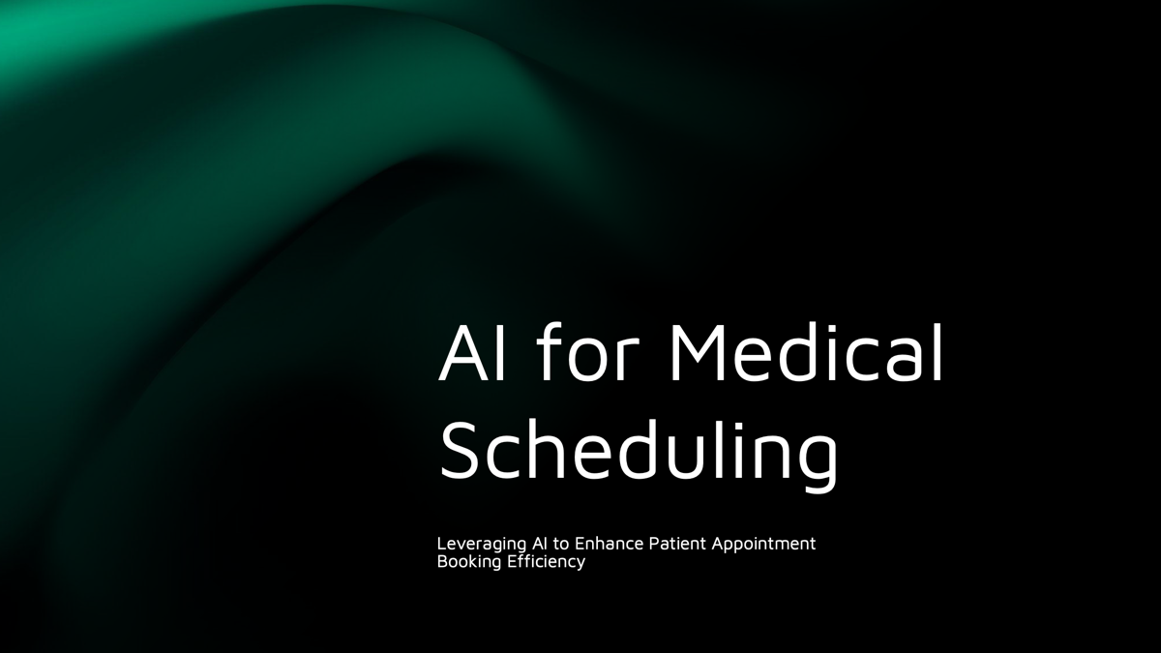
Yusuf Alam
Trayshawn Mitchell
Josh Richardson

Slide 2

Scheduling Medical Appointments is a Headache
They are stressful.
Time consuming.
And costly.

Slide 3
01
02
03
Calendar Integration
Backend Integration
AI Chatbot Interaction
Our AI Scheduling Solution Will Achieve

Slide 4
01
Calendar Integration

Slide 5
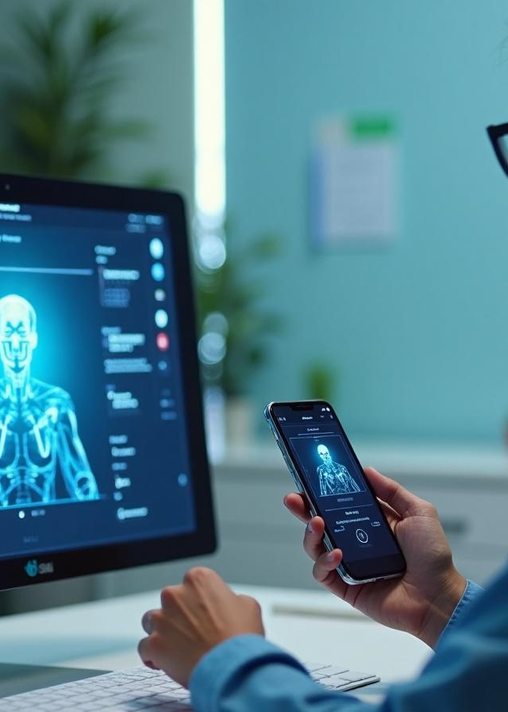
Integration with Scheduling Systems
Integrating the AI chatbot with existing scheduling systems is crucial for seamless functionality. This integration enables the chatbot to access real-time availability of doctors and streamline the appointment booking process. By coordinating with backend scheduling software, we ensure accurate data retrieval and minimize scheduling conflicts, enhancing the patient's experience throughout their journey.

Slide 6
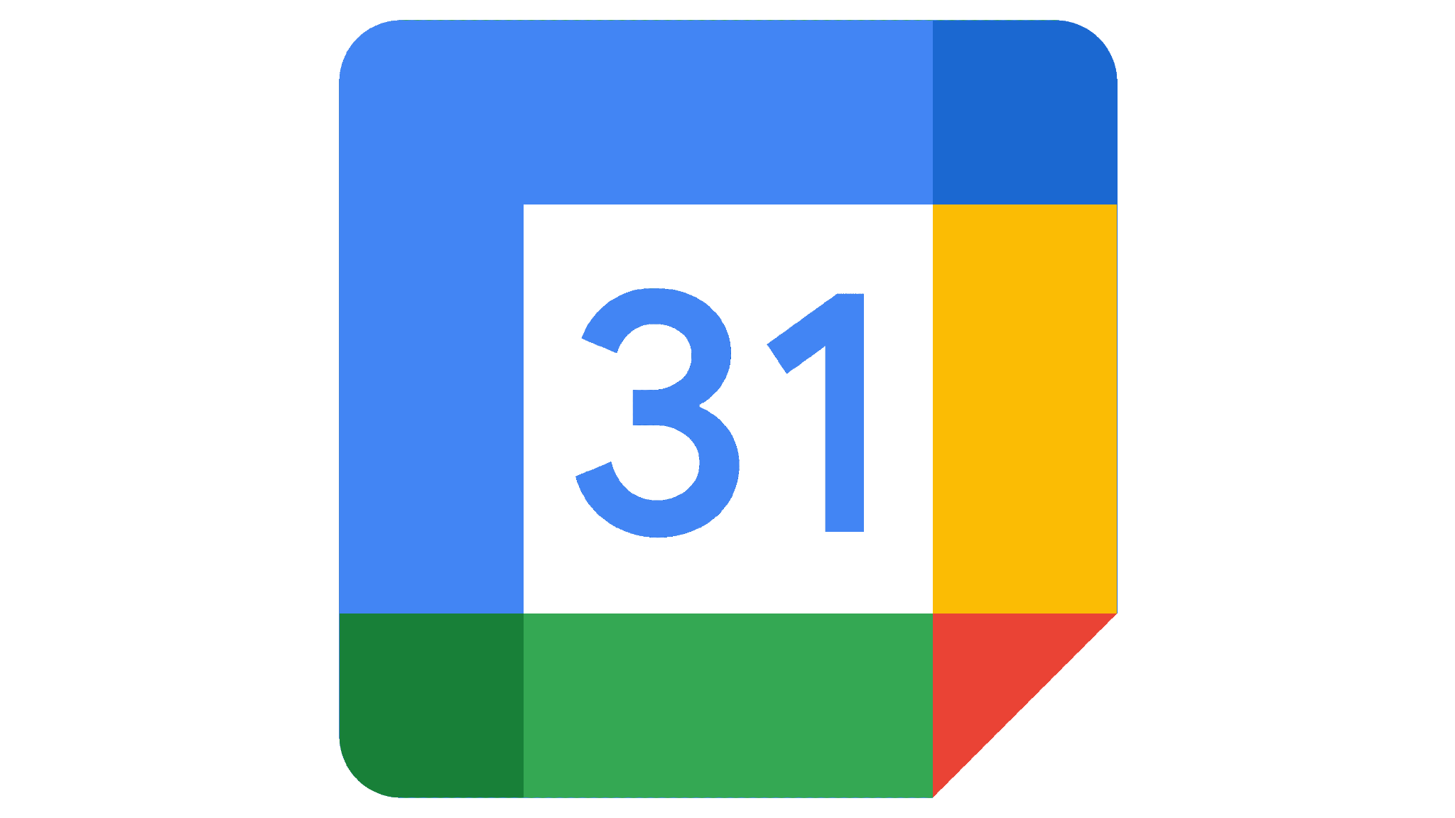
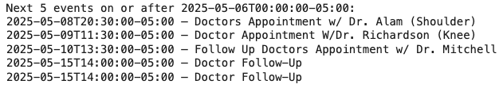
Google Calendar API Usage
Utilizing the Google Calendar API allows for direct scheduling and management of appointments within user calendars. This feature simplifies the reflection of appointments in real-time, reducing the risk of double bookings. The API facilitates secure authorization, ensuring user data privacy while allowing the necessary access for appointment management on the user's behalf.

Slide 7
02
Backend Integration

Slide 8

FHIR Data Exchange
FHIR is a RESTful API standard to share data between digital health systems
HAPI FHIR implements the standard via a publicly available test server
It was important to discover how HAPI FHIR could capture an appointment via an LLM (and eventually from a commercial scheduling software product)
https://hapifhir.io/hapi-fhir/

Slide 9
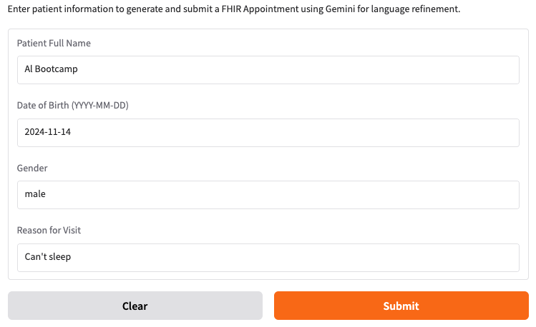
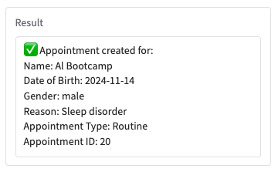
Integration with Scheduling Systems

Slide 10
LLM (Gemini) Transforms Select Appointment Data

Slide 11
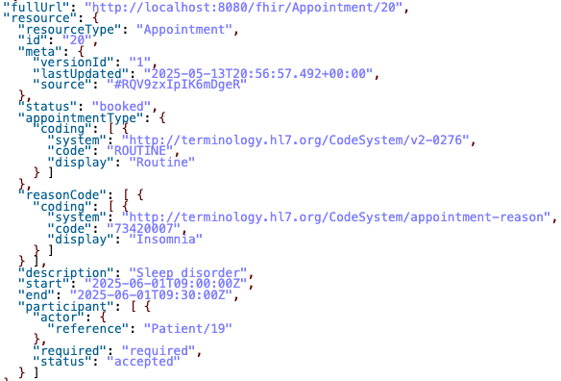
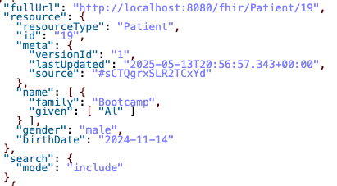
Creates a Record on a Local HAPI FHIR Server
Note: For now the date/time is hard coded

Slide 12
03
AI Chatbot Interaction

Slide 13
AI-Powered Scheduling Assistant Architecture
Objective: Seamlessly schedule medical appointments by integrating various systems (LangChain, Google Calendar, and FHIR).
Components:
Gradio Interface: User-facing application where patients (e.g., Miranda) interact with the AI assistant.
LangChain Agent: Makes decisions about scheduling, checking available time slots, and ensuring correct appointment flow.
Google Calendar Integration: Syncs patient and doctor calendars to find available time slots.
FHIR Integration: Provides patient and appointment data from a FHIR server to track and update appointments.

Slide 14
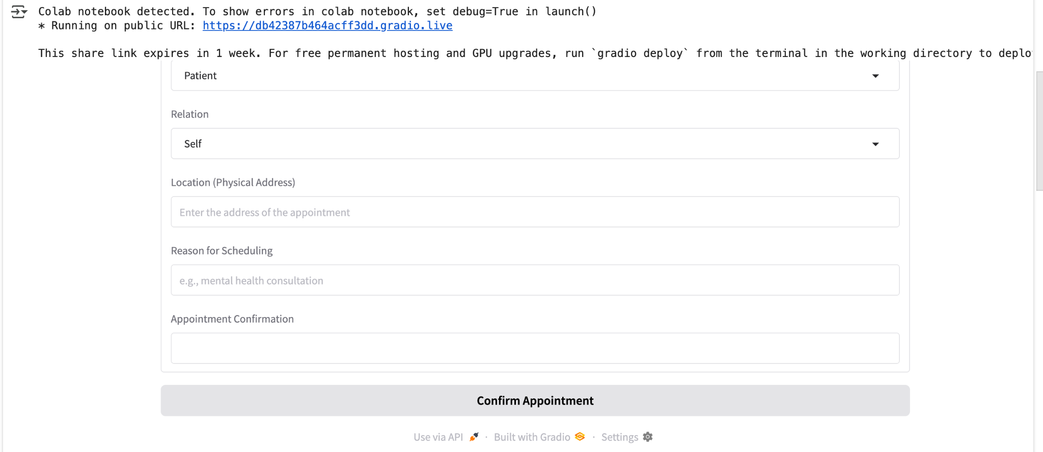
Gradio Interface – Scheduling Interaction
Key Features:
Patient Information: Collects patient name, family member’s name, reason for visit, and location.
Date and Time Input: Start time, end time, and description fields.
Appointment Confirmation: Displays available slots and allows the user to confirm the appointments.

Slide 15
Chatbot Design and Functionality
The chatbot is designed to facilitate seamless patient interactions by enabling users to request appointments through natural language processing. Its functionality includes setting parameters for various appointment types, ensuring privacy, and providing instant responses. The ultimate goal is to minimize the effort required from patients and streamline the scheduling process.
Role in Scheduling:
Interprets Input: Receives user input (e.g., reason for visit) and processes the request.
Queries Google Calendar: Checks both the patient’s and the doctor’s calendars for mutual availability.
Validates Appointment: Ensures no conflicts and recommends the best available slots.
Track Appointments: Ensure the patient’s data is up-to-date and appointment history is checked before scheduling new appointments.
Data Synchronization: FHIR ensures that all patient and appointment data is synced in real-time with other systems (like LangChain and Google Calendar).

Slide 16
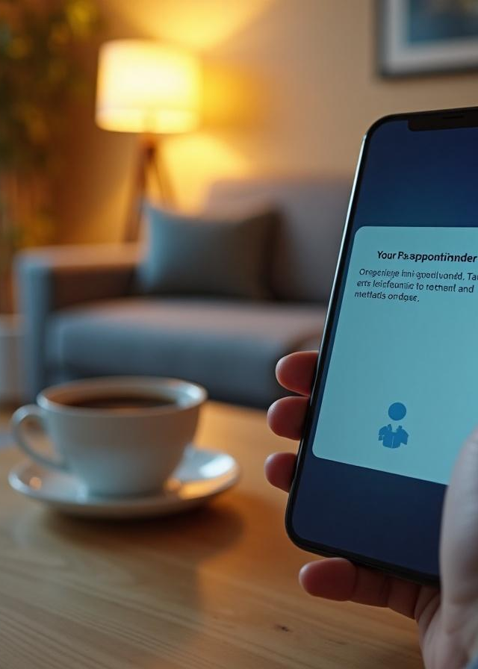
Future Work
Pencil in subsequent visits based on probabilities for follow-up and/or recurring visits
Integrate scheduling with provider availability
Integrate scheduling with any patient caregiver(s) availability

Slide 17


Thank you!
Do you have any questions?

